Slide 1
Predictive Modeling Case Competition
[Date of Presentation]
[Organization]

Slide 2

Casualty Actuarial Society
World’s only actuarial organization focused exclusively on P&C risks
100+ year track record in training property/casualty actuaries
9,000+ members worldwide, and growing
Vibrant, growing community with deep and extensive resources to help CAS members, candidates, and students advance their careers; strong employer support.

Slide 3
Case Overview

Slide 4
Background & Charge
You head up the pricing function for Alpha Beta Gamma (ABG) Insurance, a regional personal lines carrier.
Your firm is interested in expanding their business by increasing their penetration in the renter’s insurance market.
Your firm recently began selling a renter’s insurance product covering dormitory dwellings to college students.
The CEO has asked to see an outline of a newly developed pricing strategy for current and new Dormitory Insurance business.

Slide 5
Background & Charge
You will be creating a predictive model for a rental insurance policy developed for students living in dormitories
  Rental insurance covers theft of personal property (e.g. laptops)
  Rental insurance also covers medical expenses for your guests due to injuries sustained while in your rented home (e.g. slip and fall)
The use of predictive models allows insurers to design complex pricing structures to adequately charge each individual insured
  Insurers will often use rating tiers to introduce different pricing structures for different groups of insureds based on varying risk level
  Other information (e.g. GPA) can be used to differentiate pricing in each tier

Slide 6
Deliverables
The presentation and the recommendations/analysis contained within are your key deliverables. We are providing less time than other competitions, so keep this high level – we will tell the judges that was the directive
Important elements of your presentation include:
Recommendations regarding pricing structure for insureds in each tier
Discuss your approach to account for the expense component of the rate (i.e. overhead, marketing, claims adjusting, etc.)
  Consider the differences between new and renewal customers
Provide a business plan recommendation to your CEO
  Implementation guidelines on how to utilize the model and how it will impact profitability
Identification of the key assumptions underlying your analysis complete with support driven by data, from research, or based on intuition

Slide 7
Deliverables
Your presentation should:
Be well organized and concise
Help demonstrate your technical knowledge of the topic
Be tailored to your audience and their interests/potential concerns
Presentation specifics:
Target 5 minutes for the presentation
Expect 5 minutes of Q&A (for the finale)
Visualizations are strongly encouraged

Slide 8
Supporting Materials & Resources
Case
  Background/Charge
  Deliverables
  Suggested Resources
  Glossary of Terms and Definitions
Case Data & Workbook
  10,000 customers with varying degrees of risk
  Claim History
  Information about the dorm (e.g. distance to school)
  Information about the student (e.g. GPA)
Competition Rubric

Slide 9
Expectations: Competition Rubric
Category | Description of Category
Presentation Skills | This is an important skill not just for actuaries, but for anyone who will be working in a business setting. The participant will be graded on general presentation skills, clarity of presentation, and demonstration of technical knowledge of the topic.
Technical Analysis | The participant should demonstrate proper usage of the data, think critically about the problem at hand, and make reasonable additional assumptions as needed. The analysis should be clear and well-documented, and sound from an actuarial perspective. Assumptions should be explained and be reasonable.
Use of Tools | Participants may have a number of options for tools at their disposal. Each participant should choose an appropriate tool for the task at hand and justify their selection. They should demonstrate appropriate usage of the capabilities of their chosen tools.
Business Knowledge | In addition to demonstrating an understanding of the techniques used in the analysis, the participant should understand the impact of their analysis from the perspective of the business. The participant should make business recommendations based on their analysis. Additional recommendations not directly rooted in the technical analysis may further demonstrate business acumen. The case study lists additional considerations that should be discussed; these considerations should be touched on at the very least.

Slide 10
Tips for Case Competition Success

Slide 11
The Team
Get to know each other
  Interests & strengths
Develop a game plan together
  Familiarize yourself with the case early
  Assign responsibilities and set deadlines
  Have regular touchpoints
  Don’t be afraid to adjust the plan as you go
Support each other
  Bounce ideas off each other
  Overcome obstacles together
Don’t work in a silo
Communicate, communicate, communicate

Slide 12
The Analysis
Understand the business problem and who your business partners are
  What are we trying to quantify and why?
  What information will our business partners need from us?
  What questions will we need to be prepared to answer and what concerns will we need to address?
Leverage the resources provided
  Don’t recreate the wheel but don’t be afraid to deviate where it makes sense
Supplement data with research and judgement
Document key assumptions/drivers of your analysis
Do your results feel reasonable?

Slide 13
The Presentation
Presentation specifics:
  Target 5 for the presentation
  Expect 5 minutes of Q&A (in the in-person finale)
Tailor the presentation to your audience (your business partners)
  What are the key ideas we need them to walk away understanding?
  What information will they need from us to make a decision?
  What questions/concerns can we get out in front of?
Tell your story
  Assemble the slides in a logical progression
  Cover your key recommendations before diving into your supporting analysis and key assumptions
  Be well organized, concise and demonstrate your technical knowledge of the topic

Slide 14
The Presentation
Exhibits:
  Draw attention to the key numbers (shading, font color,…)
  Look for opportunities to leverage charts and visuals
  Visualizations are strongly encouraged
Practice, practice, practice

Slide 15
CAS Student Central Membership

Slide 16

You are invited…
Join online today at
CASstudentcentral.org

Slide 17
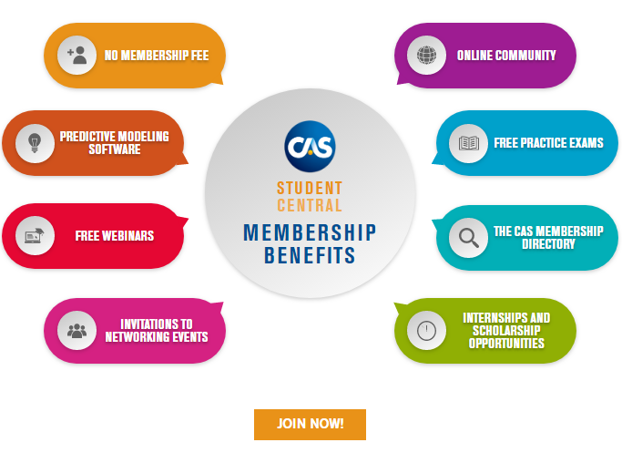
CAS Student Central Membership Benefits

